Slide 1
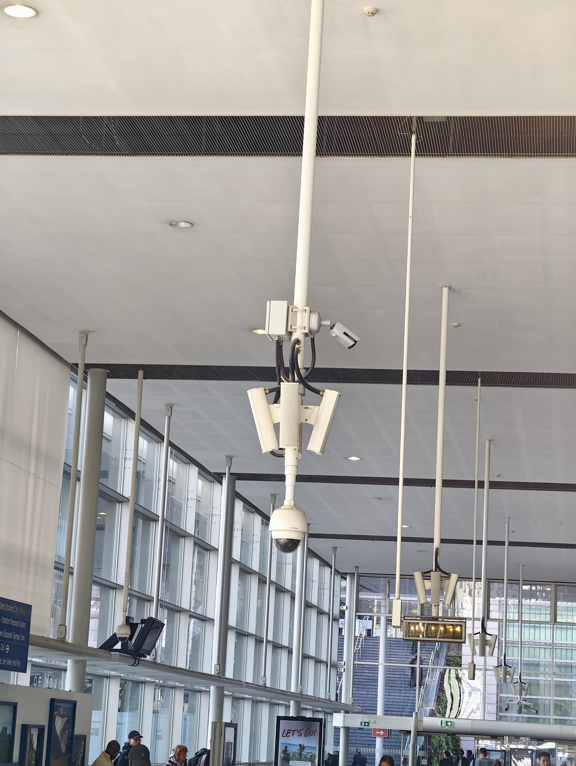
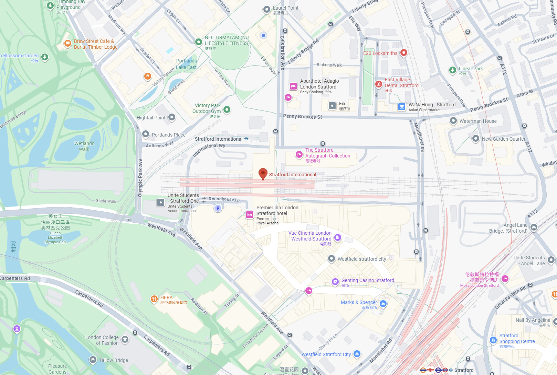
Public Surveillance and Safety Monitoring
This system is a PTZ (Pan-Tilt-Zoom) CCTV camera unit installed in a public indoor area such as a transport hub or station hall.
It continuously captures and records video footage to ensure public safety and situational awareness.
Questions when visiting site?
What areas are being monitored by this camera?
Who can access the recorded footage?
How long is the video data stored?
How is citizens’ privacy protected?
Location info:
@51.54503219729111, -0.008665316508736129
Queen Elizabeth Olympic Park, International Wy, London E20 1YY
https://maps.app.goo.gl/z6JYRgSRHhPrTzb38
Submitted: Yewei Bian Oct 2025
Notes:
A title and a couple of sentences describing the technology and possibly linking to further information online.
A photo of the technology in situ with a corresponding map showing where it is.
2 or 3 questions that you might ask when you are in situ at the site of the technology to engage others in a discussion about that technology
The following geographic data:
Lat Long
Street Address
Google maps link
What3words location
Also add in the names of those submitting this data.

